Slide 1
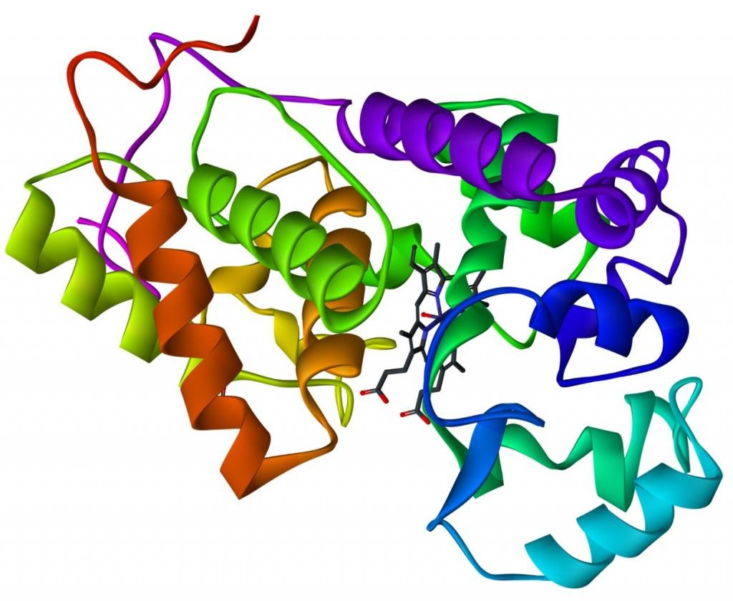
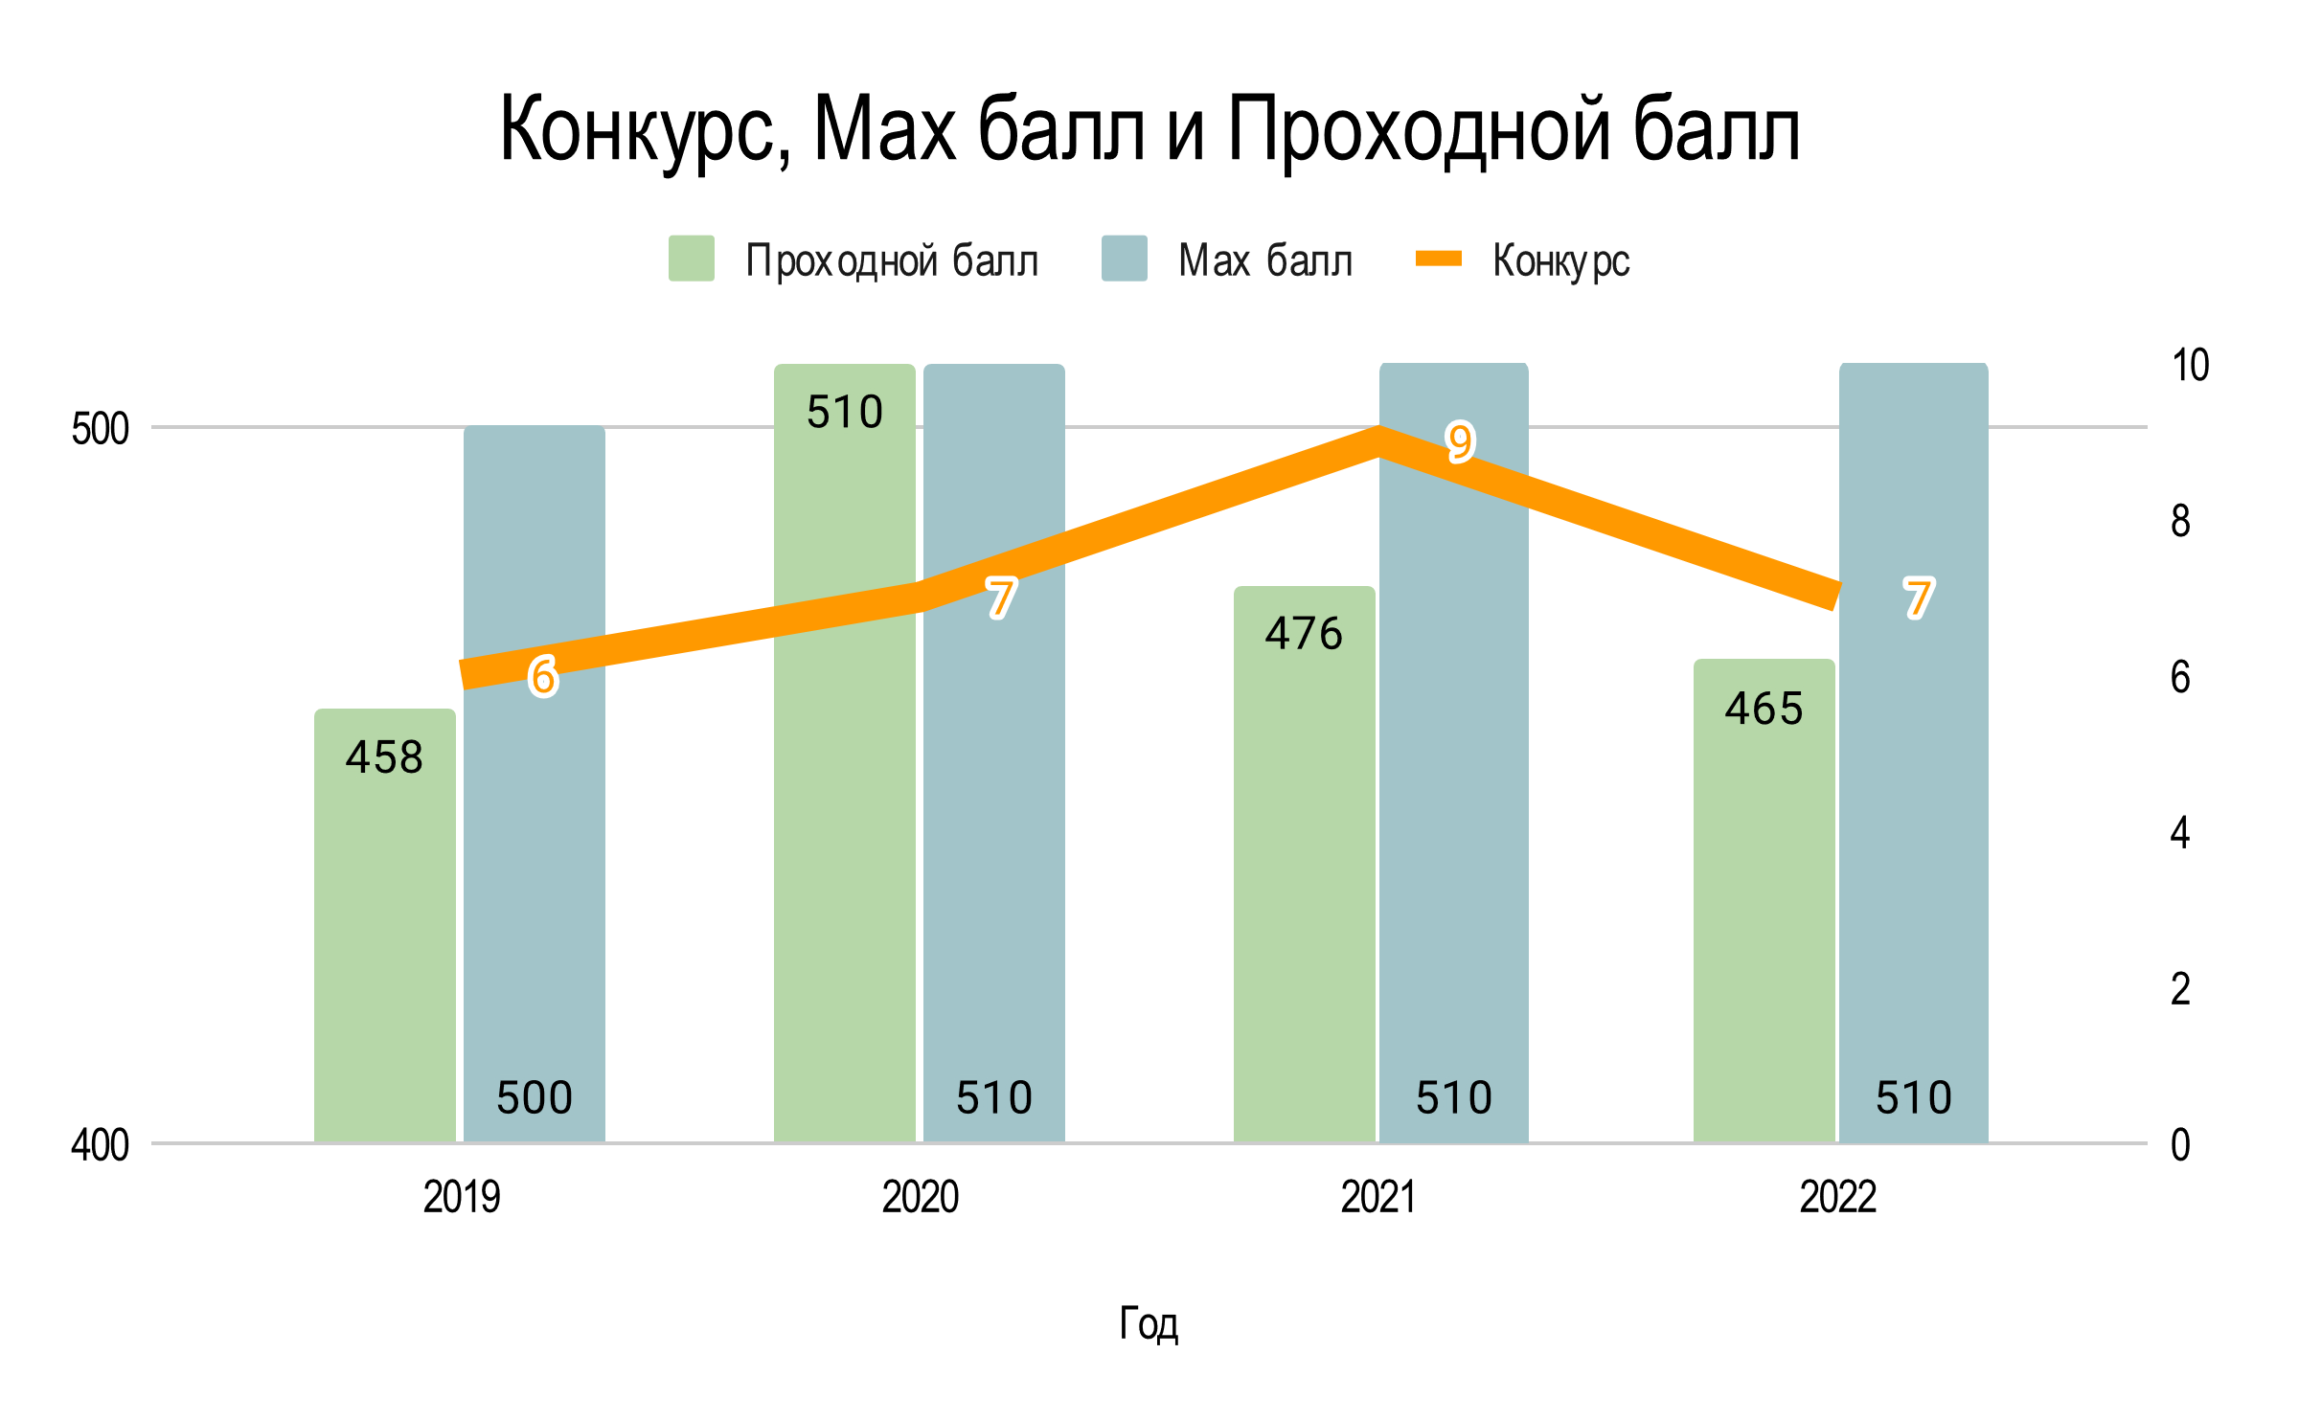
Заголовок: PT sans Narrow bold, 96pt можно в две строки, белый цвет – не влезает меньше шрифт
Авторы: черный цвет, PT sans Narrow, 48 pt, в одну строку
Место работы автора: PT sans narrow,. чёрный, 32 pt , в две строки. При необходимости – места работы давать через точку с запятой, а не с новой строки.
Заголовок 2 уровня
Текстовый блок с изображением
Заголовок второго уровня по умолчанию 96 pt черный.
Все заголовки шрифтом PT sans narrow. Заголовок выровнен по тексту в блоке, а не по его рамке.
Основной шрифт PT sans 32 pt черный. Обратите внимание, что шрифт НЕ как у заголовков. Размер шрифта можно варьировать в зависимости от количества текста на постере.
Для использования текстового блока надо скопировать этот блок, разместить в нужном месте и заменить текст.
Отступы текста от кроев блока старайтесь делать одинаковыми.
Закругление блоков такое же, как и у синего блока в шпаке.
Выравнивание от края – по синему блоку в шпаке.
Используйте изображения максимального размера и качества.
Если возможно – изображение должно быть на белом фоне, без рамок.
Для того, чтобы текст не оказывался ПОД рисунком используйте отступы белого блока справа или слева. Это можно посмотреть этом блоке если открыть «формат фигуры». Пример по ссылке https://disk.yandex.ru/i/p2_0xGdRZz8FmQ
Очень важные мысли можно выделить крупным шрифтом PT sans размера 48 pt.
Можно ставить рисунки без фона без белого блока - см ниже.
Прозрачный фон поддерживают – gif, png.
Для векторных изображений используйте svg или wmf (шрифты переводите в кривые)
Основные правила
Можно использовать светло-зеленый фон для важных избранных блоков.
Примеры неудачных решений
https://disk.yandex.ru/i/AuEyJ2s8Sw84EQ
Примеры оформления постеров на конкретном примере на слайдах далее
Оставляйте отступы от краев, ни текст, ни изображения не делайте в край блоков.
Подбирайте цветовую гамму
Следите за закруглениями блоков, они должны быть как у синего в шапке, и они меняются при изменении размеров блоков! Настраивайте их в конце!
Изображения используйте или векторные или растр 150 dpi
Если вам хочется можно весь постер делать в одном большом белом блоке (см. второй слайд)
Подпись рисунка

Slide 2
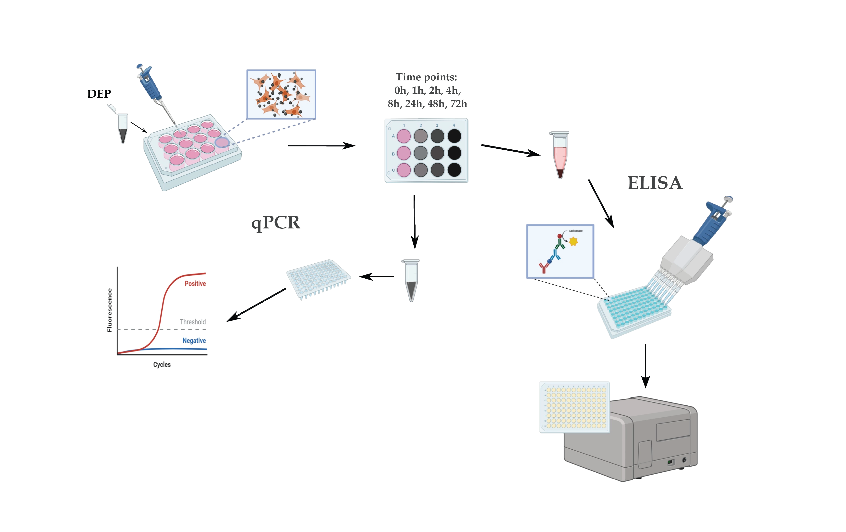
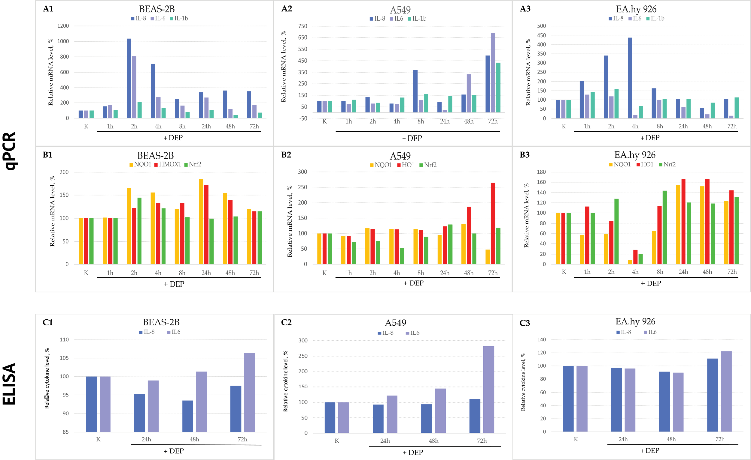
Pro-inflammatory activation and Nrf2 induction in human epithelial cells exposed to diesel exhaust particles
Anna A. Dashkevich¹ (anna.dash.221@gmail.com) Tutors: Ludmila A. Zinovkina¹, Roman A. Zinovkin²
¹ Faculty of Bioengineering and Bioinformatics, Lomonosov Moscow State University, Moscow, Russia
² A. N. Belozersky Institute of Physico-Chemical Biology, Lomonosov Moscow State University, Moscow, Russia
Introduction
Materials and methods
Aim and objectives
Exposure to diesel exhaust particles (DEP) affects cell growth and differentiation and triggers inflammatory response. Inflammation induced by DEP underlies the pathogenesis of various diseases. Transcription factor Nrf2 is the main regulator of xenobiotic metabolism and antioxidant defense system of the cell. Activation of Nrf2 and upregulation of its target genes contribute to the reduction of inflammation.
Previously it has been shown that DEP penetration can cause Nrf2 activation. There are many papers devoted to the effects of DEP on various epithelial cells, but to date there are no studies examining the effect of DEP on the Nrf2 response in endothelial cells.
To study whether diesel particles induce inflammatory activation and Nrf2 response in the endothelial EA.hy926 line in comparison with other epithelial cells: A549 (lung carcinoma), BEAS-2B (bronchial epithelium).
To evaluate relative cytokine IL-6 and IL-8 release in BEAS-2B, A549 and EA.hy 926 cells treated with DEP
To measure mRNA levels for the Nrf2 targets NQO1 and HMOX1 in BEAS-2B, A549 and EA.hy926 cells treated with DEP
To evaluate relative cytokine IL-6 and IL-8 release in BEAS-2B, A549 and EA.hy926 cells treated with DEP
Results
Fig.2 A: Relative mRNA level of IL-8, IL-6 and IL-1b in BEAS-2B, A549 and EA.hy 926 cell lines determined by qPCR.
Conclusions
DEP temporarily upregulated the mRNA expression level of the inflammatory cytokines IL-6 and IL-8 in BEAS-2B, A549, and EA.hy 926 cells.
The mRNA expression of the Nrf2 targets NQO1 and HMOX1 also increased in these DEP-treated cells; however, the mRNA for the Nrf2 gene remained unchanged.
DEP induced IL-6 release from all DEP-treated cells, while the IL-8 cytokine level remained unchanged.
B: Relative mRNA level of Nrf2, HMOX1 and NQO1 in BEAS-2B, A549 and EA.hy 926 cell lines determined by qPCR.
Fig.2 C: Relative cytokines IL-8 and IL-6 level in BEAS-2B, A549 and EA.hy 926 cell lines determined by enzyme immunoassay (ELISA).

Slide 3
Pro-inflammatory activation and Nrf2 induction in human epithelial cells exposed to diesel exhaust particles
Anna A. Dashkevich¹ (anna.dash.221@gmail.com) Tutors: Ludmila A. Zinovkina¹, Roman A. Zinovkin²
¹ Faculty of Bioengineering and Bioinformatics, Lomonosov Moscow State University, Moscow, Russia
² A. N. Belozersky Institute of Physico-Chemical Biology, Lomonosov Moscow State University, Moscow, Russia
Introduction
Materials and methods
Aim and objectives
Exposure to diesel exhaust particles (DEP) affects cell growth and differentiation and triggers inflammatory response. Inflammation induced by DEP underlies the pathogenesis of various diseases. Transcription factor Nrf2 is the main regulator of xenobiotic metabolism and antioxidant defense system of the cell. Activation of Nrf2 and upregulation of its target genes contribute to the reduction of inflammation.
Previously it has been shown that DEP penetration can cause Nrf2 activation. There are many papers devoted to the effects of DEP on various epithelial cells, but to date there are no studies examining the effect of DEP on the Nrf2 response in endothelial cells.
To study whether diesel particles induce inflammatory activation and Nrf2 response in the endothelial EA.hy926 line in comparison with other epithelial cells: A549 (lung carcinoma), BEAS-2B (bronchial epithelium).
To evaluate relative cytokine IL-6 and IL-8 release in BEAS-2B, A549 and EA.hy 926 cells treated with DEP
To measure mRNA levels for the Nrf2 targets NQO1 and HMOX1 in BEAS-2B, A549 and EA.hy926 cells treated with DEP
To evaluate relative cytokine IL-6 and IL-8 release in BEAS-2B, A549 and EA.hy926 cells treated with DEP
Results
Fig.2 A: Relative mRNA level of IL-8, IL-6 and IL-1b in BEAS-2B, A549 and EA.hy 926 cell lines determined by qPCR.
Conclusions
B: Relative mRNA level of Nrf2, HMOX1 and NQO1 in BEAS-2B, A549 and EA.hy 926 cell lines determined by qPCR.
DEP temporarily upregulated the mRNA expression level of the inflammatory cytokines IL-6 and IL-8 in BEAS-2B, A549, and EA.hy 926 cells.
The mRNA expression of the Nrf2 targets NQO1 and HMOX1 also increased in these DEP-treated cells; however, the mRNA for the Nrf2 gene remained unchanged.
DEP induced IL-6 release from all DEP-treated cells, while the IL-8 cytokine level remained unchanged.
Заголовок 2 уровня
Fig.2 C: Relative cytokines IL-8 and IL-6 level in BEAS-2B, A549 and EA.hy 926 cell lines determined by enzyme immunoassay (ELISA).

Slide 4
Pro-inflammatory activation and Nrf2 induction in human epithelial cells exposed to diesel exhaust particles
Anna A. Dashkevich¹ (anna.dash.221@gmail.com) Tutors: Ludmila A. Zinovkina¹, Roman A. Zinovkin²
¹ Faculty of Bioengineering and Bioinformatics, Lomonosov Moscow State University, Moscow, Russia
² A. N. Belozersky Institute of Physico-Chemical Biology, Lomonosov Moscow State University, Moscow, Russia
Introduction
Materials and methods
Aim and objectives
Exposure to diesel exhaust particles (DEP) affects cell growth and differentiation and triggers inflammatory response. Inflammation induced by DEP underlies the pathogenesis of various diseases. Transcription factor Nrf2 is the main regulator of xenobiotic metabolism and antioxidant defense system of the cell. Activation of Nrf2 and upregulation of its target genes contribute to the reduction of inflammation.
Previously it has been shown that DEP penetration can cause Nrf2 activation. There are many papers devoted to the effects of DEP on various epithelial cells, but to date there are no studies examining the effect of DEP on the Nrf2 response in endothelial cells.
To study whether diesel particles induce inflammatory activation and Nrf2 response in the endothelial EA.hy926 line in comparison with other epithelial cells: A549 (lung carcinoma), BEAS-2B (bronchial epithelium).
To evaluate relative cytokine IL-6 and IL-8 release in BEAS-2B, A549 and EA.hy 926 cells treated with DEP
To measure mRNA levels for the Nrf2 targets NQO1 and HMOX1 in BEAS-2B, A549 and EA.hy926 cells treated with DEP
To evaluate relative cytokine IL-6 and IL-8 release in BEAS-2B, A549 and EA.hy926 cells treated with DEP
Results
Fig.2 A: Relative mRNA level of IL-8, IL-6 and IL-1b in BEAS-2B, A549 and EA.hy 926 cell lines determined by qPCR.
Conclusions
DEP temporarily upregulated the mRNA expression level of the inflammatory cytokines IL-6 and IL-8 in BEAS-2B, A549, and EA.hy 926 cells.
The mRNA expression of the Nrf2 targets NQO1 and HMOX1 also increased in these DEP-treated cells; however, the mRNA for the Nrf2 gene remained unchanged.
DEP induced IL-6 release from all DEP-treated cells, while the IL-8 cytokine level remained unchanged.
B: Relative mRNA level of Nrf2, HMOX1 and NQO1 in BEAS-2B, A549 and EA.hy 926 cell lines determined by qPCR.
Fig.2 C: Relative cytokines IL-8 and IL-6 level in BEAS-2B, A549 and EA.hy 926 cell lines determined by enzyme immunoassay (ELISA).

Slide 5
Pro-inflammatory activation and Nrf2 induction in human epithelial cells exposed to diesel exhaust particles
Anna A. Dashkevich¹ (anna.dash.221@gmail.com) Tutors: Ludmila A. Zinovkina¹, Roman A. Zinovkin²
¹ Faculty of Bioengineering and Bioinformatics, Lomonosov Moscow State University, Moscow, Russia
² A. N. Belozersky Institute of Physico-Chemical Biology, Lomonosov Moscow State University, Moscow, Russia
Introduction
Materials and methods
Aim and objectives
Exposure to diesel exhaust particles (DEP) affects cell growth and differentiation and triggers inflammatory response. Inflammation induced by DEP underlies the pathogenesis of various diseases. Transcription factor Nrf2 is the main regulator of xenobiotic metabolism and antioxidant defense system of the cell. Activation of Nrf2 and upregulation of its target genes contribute to the reduction of inflammation.
Previously it has been shown that DEP penetration can cause Nrf2 activation. There are many papers devoted to the effects of DEP on various epithelial cells, but to date there are no studies examining the effect of DEP on the Nrf2 response in endothelial cells.
To study whether diesel particles induce inflammatory activation and Nrf2 response in the endothelial EA.hy926 line in comparison with other epithelial cells: A549 (lung carcinoma), BEAS-2B (bronchial epithelium).
To evaluate relative cytokine IL-6 and IL-8 release in BEAS-2B, A549 and EA.hy 926 cells treated with DEP
To measure mRNA levels for the Nrf2 targets NQO1 and HMOX1 in BEAS-2B, A549 and EA.hy926 cells treated with DEP
To evaluate relative cytokine IL-6 and IL-8 release in BEAS-2B, A549 and EA.hy926 cells treated with DEP
Results
Fig.2 A: Relative mRNA level of IL-8, IL-6 and IL-1b in BEAS-2B, A549 and EA.hy 926 cell lines determined by qPCR.
Conclusions
DEP temporarily upregulated the mRNA expression level of the inflammatory cytokines IL-6 and IL-8 in BEAS-2B, A549, and EA.hy 926 cells.
The mRNA expression of the Nrf2 targets NQO1 and HMOX1 also increased in these DEP-treated cells; however, the mRNA for the Nrf2 gene remained unchanged.
DEP induced IL-6 release from all DEP-treated cells, while the IL-8 cytokine level remained unchanged.
B: Relative mRNA level of Nrf2, HMOX1 and NQO1 in BEAS-2B, A549 and EA.hy 926 cell lines determined by qPCR.
Заголовок 2 уровня
Fig.2 C: Relative cytokines IL-8 and IL-6 level in BEAS-2B, A549 and EA.hy 926 cell lines determined by enzyme immunoassay (ELISA).

